Slide 1

Creating Carer Friendly Workplaces
Knowledge Sharing Session

Slide 2
Agenda
Member Introductions
COVID-19 Work and Care Presentations
  Sari Tervonen & Miika Kataja, Carers Finland
  Emily Holzhausen & Katherine Wilson, Carers UK
  Allison Williams, McMaster University, Canada
  Laurie Hilsgen, Carers New Zealand
Wrap-up

Slide 3

IACO Vision, Mission, Goals
VISION: To establish a global understanding and recognition of the essential role of carers with respect to care recipients, health and social care systems and society.
MISSION: To improve the quality of life and support the needs of carers through international partnerships and advocacy that strengthen and honour the voice of carers.
STRATEGIC GOALS:
  Awareness: IACO will increase global awareness and recognition of carers with opinion leaders and key global health and social care organisations.
  Understanding: Increase understanding of the impact and influence caring has on carers’ and care recipients’ health outcomes, health and social care systems and economies.
  Impact: Foster a worldwide movement to recognise and support carers through the creation and promotion of a Global Carers Strategy and Action Plan.

Slide 4

WORK AND CARE:
FINLAND

Slide 5
Initiatives of Carers Finland for Employment and Caring:
”Rahkeet riittämään” -project in Support of Working Age Carers 2020-2022
IACO Members Meeting 3.12.2020

Slide 6
Focus of the project: three key issues in employment and caring, and support for working age carers
Shortage of up-to-date information and straightforward instructions how to combine work and caring; legislation and working practices are overly complicated for many
Currently often inadequate focused support for working age carers in local carer organisations
Call for more open discussion about combining work and caring and need for changes in key legislation that affect combining employment and care

Slide 7
Issue 1: Information and instructions
Building an accessible “knowledge bank”
Up-to-date information on Finnish legislation and current practices in bite size, user friendly pieces
Collected tacit knowledge and gathering voice of the carers (i.e. podcast, videos etc.) about issues concerning working age carers
Comparison of informal care regimes and support in different countries and descriptions of best practices
For 1) carers in need of support and 2) professionals working with working age carers, especially government’s or municipalities’ officials

Slide 8
Issue 2: Support for working age carers
Developing new models of third sector support for working age carers
Key focus is in group support: implementing and further developing best practices, with new content and improved means to reach target audience
Also group and personal support that is taken straight into the workplace (using the “knowledge bank”)

Slide 9
Issue 3: Need for discussion and change
Combining work and care is not something that is traditionally talked about in Finnish workplace or labour policy making:
National campaign that tries to incite discussion about employment and care, and the caregivers right to work
Building more caregiver friendly work life through workshops with major national trade unions and employer organizations
Influencing ongoing reform processes (social care and welfare reform; social security reform) and legislation changes (i.e. implementation of work-life balance directive)

Slide 10
Thanks!
Contact:
Miika Kataja M. Sc. (econ.), M. Soc. Sc., Ph.D. candidate
Project manager, “Rahkeet riittämään” -Project in Support of Working Age Carers
miika.kataja@omaishoitajat.fi; +358 40 718 4156 (also WhatsApp)

Slide 11

WORK AND CARE:
UNITED KINGDOM

Slide 12



Carers, employment and the pandemic
3 December 2020
Emily Holzhausen, Director of Policy and Public Affairs Katherine Wilson, Head of Employers for Carers
Carers UK

Slide 13

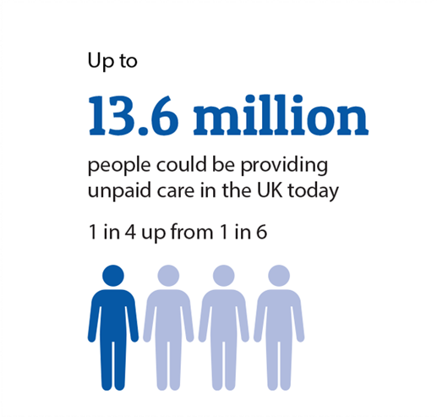
Report released 8 June 2020
More people are caring
The majority are working
Carers are stressed and exhausted

Slide 14

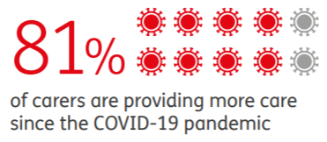

Impacts of COVID-19, and six months on
Early on, 70% were providing more care, this increased 11% in six months
81% of carers are spending more money
78% are caring for someone whose support needs have increased
64% have not had a break
64% have worse mental health

Slide 15
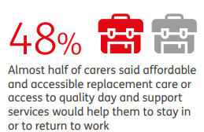
Impacts on work
11% of carers reported that they had reduced their hours
9% had given up work
Services being closed or reduced was the biggest factor

Slide 16


Employer response
75% offered additional flexible working arrangements
42% offered additional leave arrangements
49% had developed or will develop new policies or procedures
Employers for Carers has delivered numerous workshops for members for 1,000s of carers

Slide 17
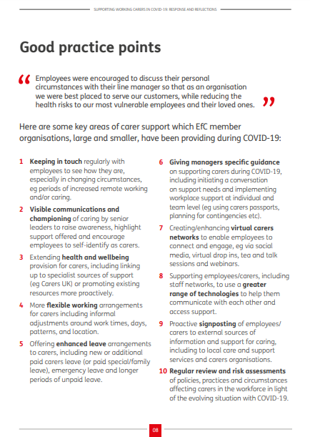
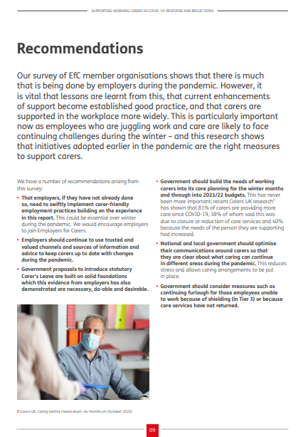

Slide 18
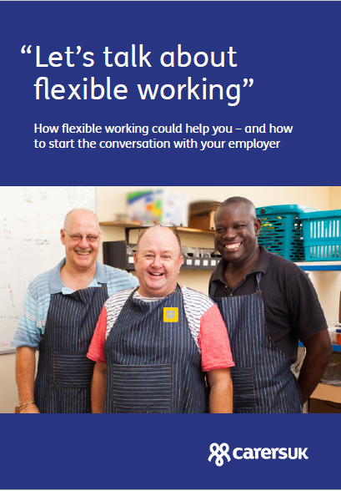
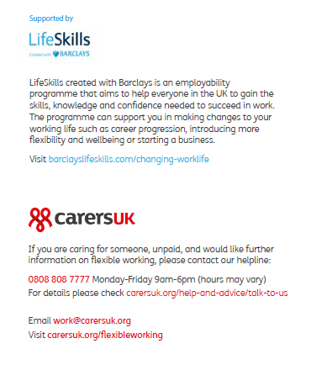

Slide 19


Slide 20
Contact:
www.employersforcarers.org/news
www.carersuk.org

Slide 21

WORK AND CARE:
CANADA

Slide 22
ISO Technical Committee on Ageing Societies – TC 314
Project: Guidelines for Carer Inclusive Organizations
Working Group 3
Secretariat : Canada
Allison Williams,Convenor
Jeanne Bank, Secretary

Slide 23
Membership of Working Group
30 Committee member experts:
Canada UK Norway
US Ireland Finland
Australia China Sweden
Korea Singapore Uganda
2 Liaison Members: European Trade Union Organization (ETUO) & Euro carers
7 Document monitors

Slide 24

Project Status
Project initiated in March 2019
Proposed by Canada – using CSA Standard B701 as basis for international standard
Committee draft approved in May 2020
Draft Standard just released for wide public review
Despite challenges of COVID, project is progressing well with valuable input from members to make it relevant and appropriate for an international audience

Slide 25
Project Timeline
Activities /deliverables | Target
Meeting 1 Meeting # 2 ( virtual) Meeting # 3 ( in person & virtual - Toronto – CSA offices) | April 2019 Sept. 2019 Nov. 5-6th 2019
Working Draft Committee Draft ballot issued | Dec. 2019 March 2020
Meeting # 4 (virtual) to review comments on committee draft | July 2020
Draft International Standard ballot issued (public review) Meeting # 5 (virtual to resolve comments from public review) | Nov/ 20– Feb/21 Mar.-Apr. 2021
Final Draft approval vote by Technical Committee (FDIS) Publication | July 2021 Jan. 2022

Slide 26

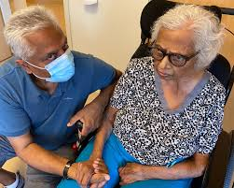
Key elements of standard
Building the foundation
Guiding principles to follow
Getting top management commitment
Assessing your workplace situation
Involving all workers
Developing policies and program elements
Putting the standard into practice
Setting goals and targets
Best practice suggestions
Building awareness
Preparing for emergencies
Tracking actions
Continual improvement
Review progress and impact
Work to continually improve program

Slide 27
Tools to help with implementation
Guiding principles added at beginning of document to help organizations focus actions on key priorities
Annex A - a sex/gender lens to help organizations understand and address the gendered aspect of caregiving and the impact of factors such as gender & age on working carers
Annex B - Checklist to help organizations apply the standard
New guidance on emergency caregiving situations such as pandemics

Slide 28

Next steps
Member bodies to consult with
stakeholders and submit vote
& comments by Feb. 10/21
All comments to be reviewed &
resolved by WG
Final draft standard to be prepared
for approval by Technical Committee
Final edits and publication

Slide 29

Obtain a copy of the draft from your ISO national member body
Submit comments to your national member body by deadline
Note: all comments will be reviewed and resolved by the WG
Please share information about the draft standard with your networks using the following link:
https://committee.iso.org/sites/tc314/home/news.html
For more information on how to submit comments, please contact:
Committee manager: nele.zgavc@bsigroup.com
Working Group secretary: bank.jeanne@gmail.com

Slide 30

WORK AND CARE:
NEW ZEALAND

Slide 31

CareWise
Helping carers keep working + earning

Slide 32



The path to CareWise
10 years of thinking and following Carers UK’s success with Employers for Carers
In NZ 1 in 8 of every workforce is a family, whānau, aiga carer
Two thirds are women
Almost 90% of NZ’s carers are workforce age earning10% less then peers
One of Carers NZ’s top strategic goals: help carers keep working and earning
CareWise was formally launched in May during NZ’s first lockdown

Slide 33
The path was rocky!
Developed with Business NZ, trades unions, and employers
Feedback: don’t do a subscription model or a ‘tick’ programme
How, then, to fund such a programme?
The Ministry of Social Development seed funded CareWise to keep it free for employers as an outcome of the Mahi Aroha Carers’ Strategy Action Plan
More than 50 mostly large enterprises so far signed up or engaged
Lesson: each relationship takes more time than expected

Slide 34
Employment landscape
More companies moving to four day weeks and flexible work
NZ moving to 10 days’ sick leave a year (currently 5)
Some organisations trialling unlimited sick leave
Covid has accelerated remote working and working from home
This doesn’t work for all carers – a new frontier in the work/care juggle
Now targeting SMEs with CareWise: most Kiwi employers are small

Slide 35
Early results
Understanding hidden caring workforce eye-opening for employers
‘Lunch and learns’, focus groups bring issues into the open
Prompts HR innovation in areas like leave or emergency leave planning
Business association partnerships: need to be deeper, will take time
Government commitment and investment: need for partnership
Overcoming the HR diversity and inclusion ‘box tick’
A decade of work ahead!

Slide 36
Together the members of IACO will create global recognition and understanding of the essential role of carers with respect to care recipients, health and social care systems and society.
Through collaborative engagement IACO will disseminate knowledge and advocate for programs, policies and legislation that support carers.

